Slide 1
Pizza Central
FINAL PROJECT OUTPUT
IT 2103
WEB APPLICATIONS DEVELOPMENT & EMERGING TECHNOLOGIES
by:
Burce, Kyle Matthew Laurence C.
Yu, Ridenzel T.

Slide 2
Rationale
Promotion of small scale businesses in the food industry; especially small pizza parlors
Convenience in hosting of such business all in one site
Provide data analysis in consumer buying habits

Slide 3

Pizzeria Michelangelo
Established: 2017
Owner: Michelle Lhullier
Branches & Locations
One Paseo, Paseo Saturnino, Cebu City, 6000 Cebu
Mantawi Avenue, Tipolo, Mandaue City, 6014 Cebu
General Maxilom Ave, Cebu City, Cebu
Industry: Food & Service Industry

Slide 4

Existing Online Presence
https://web.facebook.com/PizzeriaMichelangeloPhilippines/?_rdc=1&_rdr

Slide 5
Use Case Diagram

Slide 6
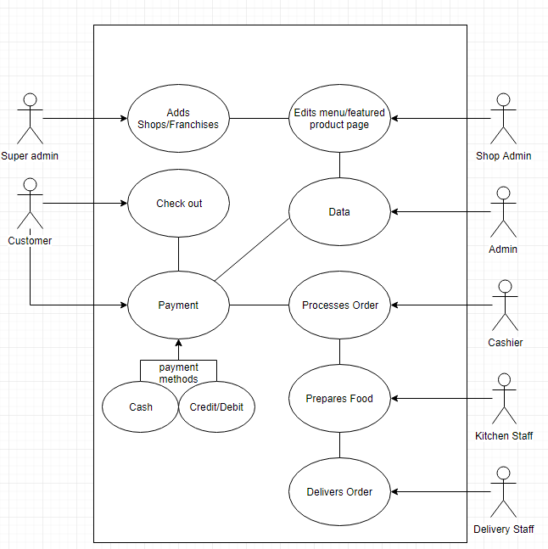

Slide 7
ERD

Slide 8
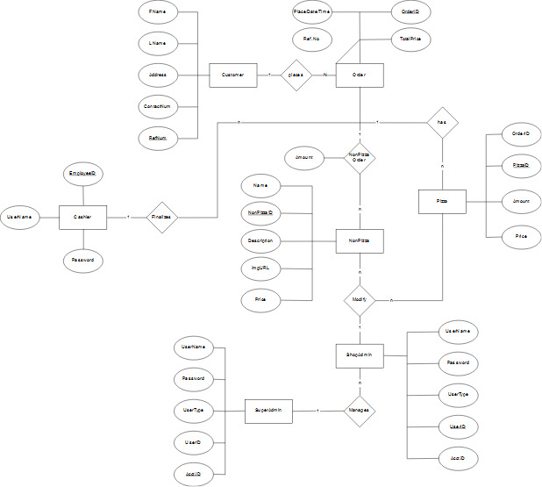

Slide 9
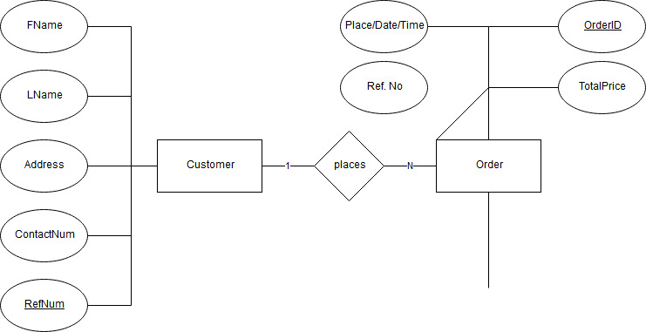

Slide 10
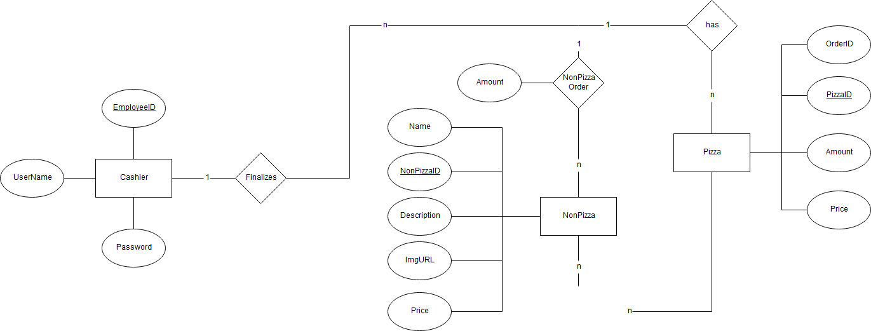

Slide 11
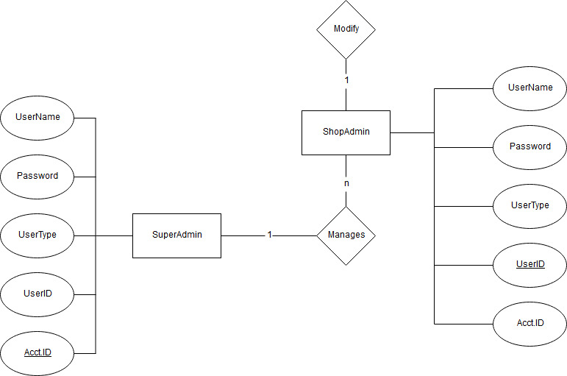

Slide 12
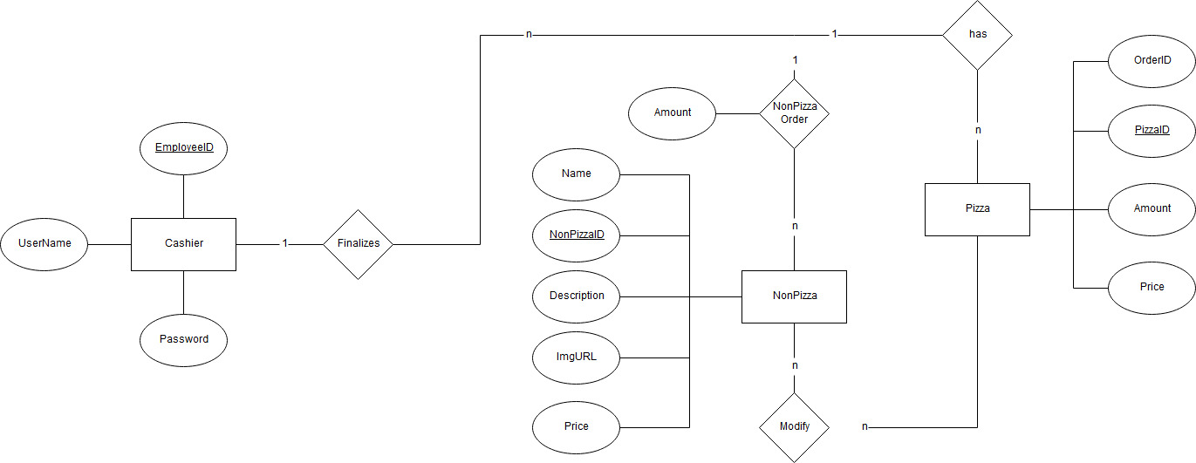

Slide 13
Business Process Flow

Slide 14
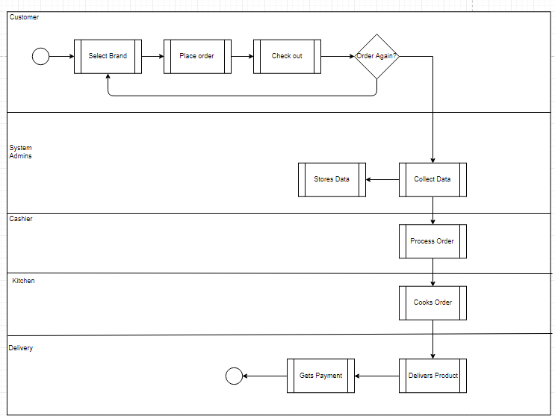

Slide 15
Mockups

Slide 16
